Slide 1
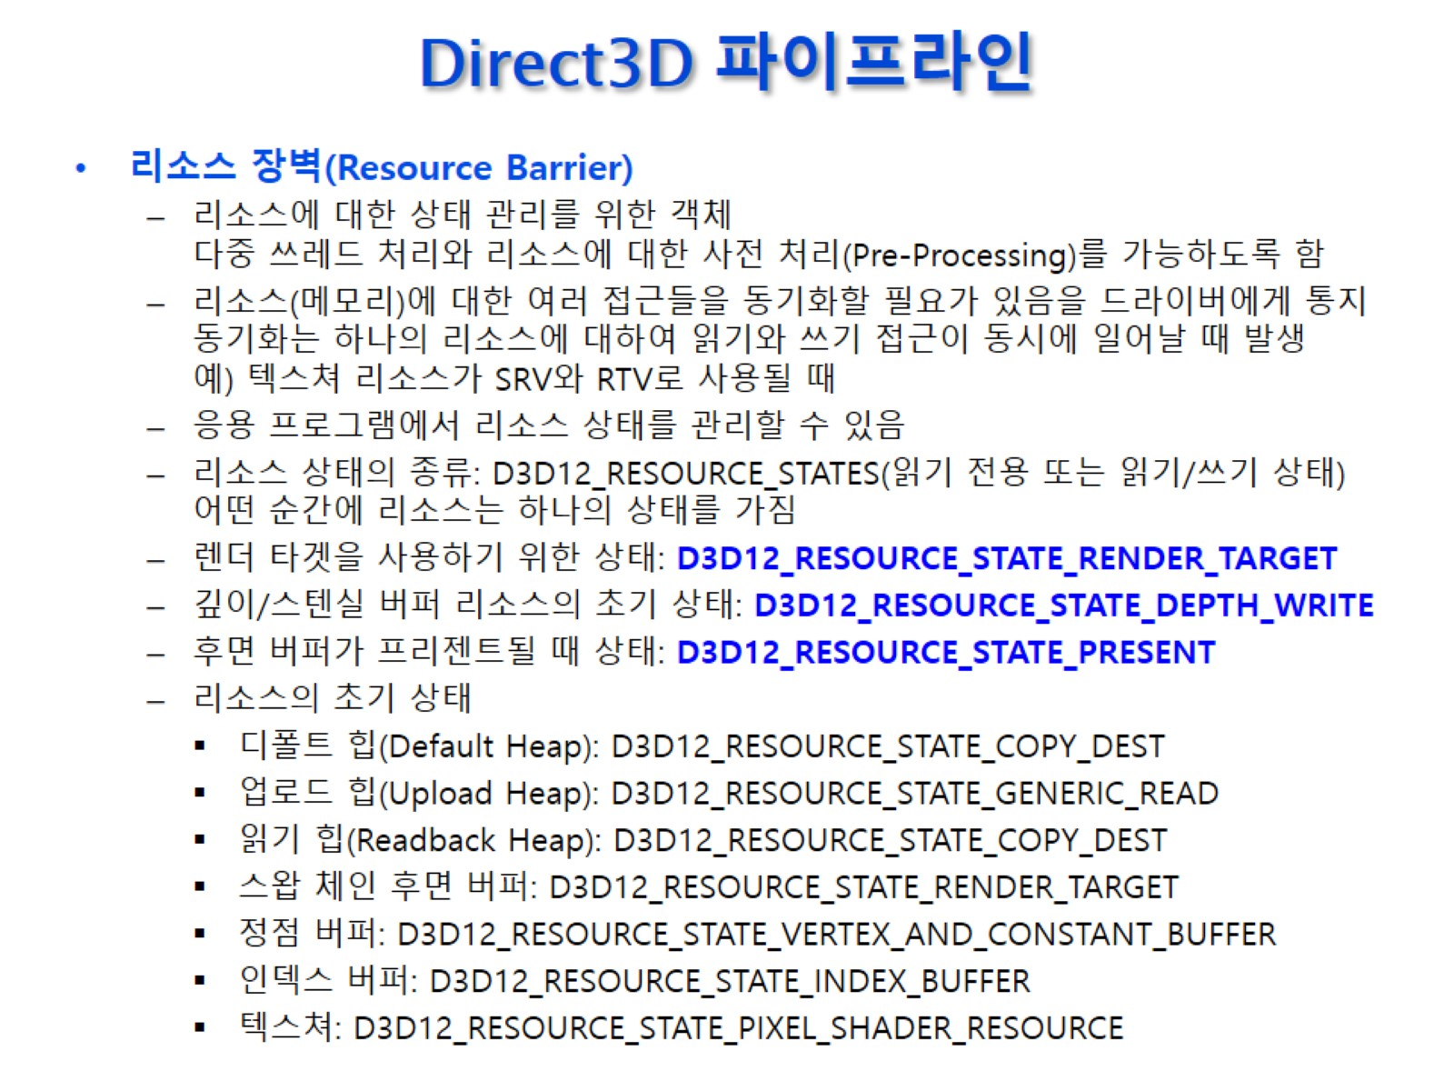
Direct3D 파이프라인
Notes:
렌더타깃 – 그래픽 파이프라인이 그림을 그리기 위해 이 리소스를 쓴다. 기본적으로 write가능 이어야 한다. Present가 제대로 수행되려면 그 상태에 아무도 write하면 안된다.
한 프레임이 완료됬다면 이 상태를 바꿔준다. ->Present스테이트
매 프레임마다 allocator, list를 reset한다.
-> present를 렌더타깃 스테이트로 바꾸고
렌더타깃 뷰를 클리어 한 후 그린다.
마지막 Present 하기 전에 present스테이트로 바꾼다.
모든 리소스의 상태는 우리가 명시적으로 관리해줘야 한다.
업로드힙은 모든 리소스는 GPU에 있다고 가정하므로 모든 스테이트는 GPU기준이다.-> 업로드힙는 READ ONLY의 의미를 갖고 있는
리소스들은 이런 초기상태를 가져야한다.

Slide 2
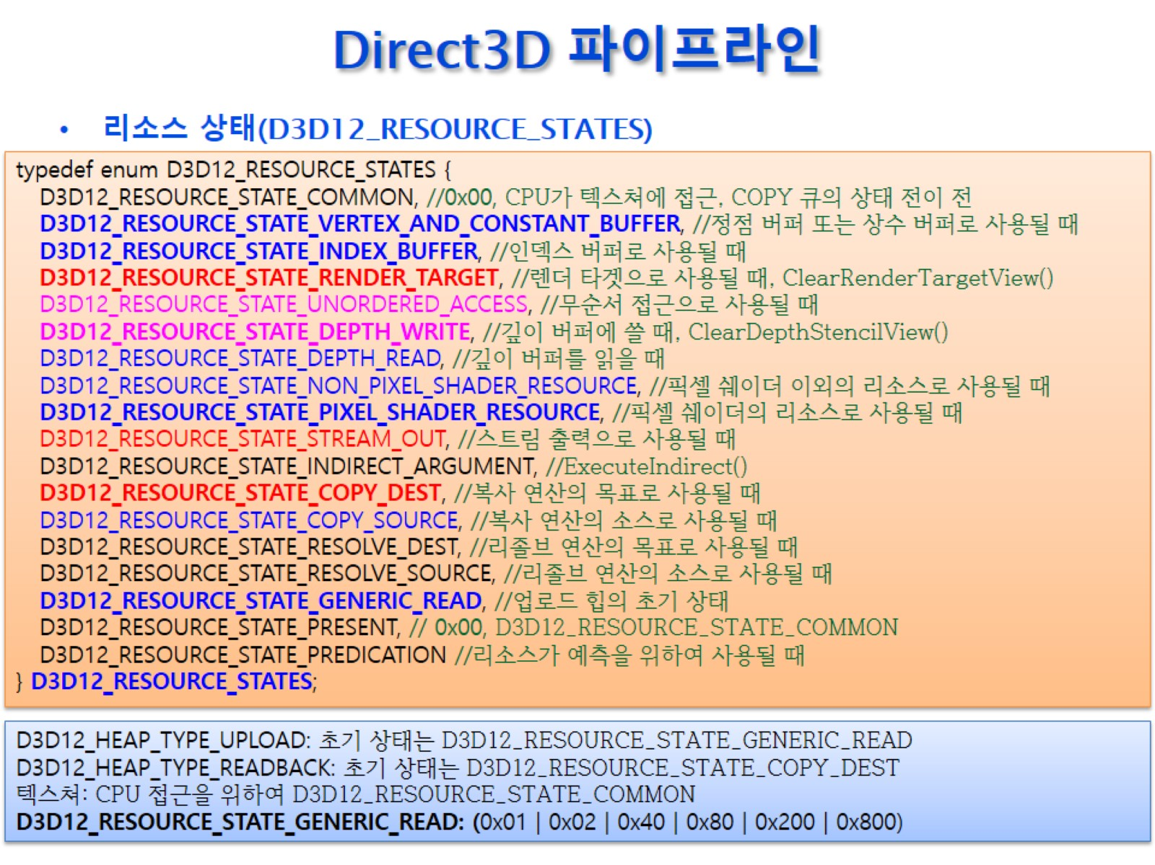
Direct3D 파이프라인
Notes:
분홍색 : 리드, 라이트 가능
비트 와이즈 or로 여러 개를 쓸 수 있다.
D3D12_RESOURCE_STATE_COMMONApplications should only transition to this state for accessing a resource across different graphics engine types.
Specifically, a resource must be in the COMMON state before being used on a COPY queue (when previous used on DIRECT/COMPUTE), and before being used on DIRECT/COMPUTE (when previously used on COPY). This restriction does not exist when accessing data between DIRECT and COMPUTE queues.
The COMMON state can be used for all usages on a Copy queue using the implicit state transitions. For more information, in Synchronization and Multi-Engine, find "common".
Additionally, textures must be in the COMMON state for CPU access to be legal, assuming the texture was created in a CPU-visible heap in the first place.
D3D12_RESOURCE_STATE_VERTEX_AND_CONSTANT_BUFFERA subresource must be in this state when it is accessed by the 3D pipeline as a vertex buffer or constant buffer. This is a read-only state.
D3D12_RESOURCE_STATE_INDEX_BUFFERA subresource must be in this state when it is accessed by the 3D pipeline as an index buffer. This is a read-only state.
D3D12_RESOURCE_STATE_RENDER_TARGETThe resource is used as a render target. A subresource must be in this state when it is rendered to or when it is cleared with ID3D12GraphicsCommandList::ClearRenderTargetView. This is a write-only state. To read from a render target as a shader resource the resource must be in either D3D12_RESOURCE_STATE_NON_PIXEL_SHADER_RESOURCE or D3D12_RESOURCE_STATE_PIXEL_SHADER_RESOURCE.
D3D12_RESOURCE_STATE_UNORDERED_ACCESSThe resource is used for unordered access. A subresource must be in this state when it is accessed by the 3D pipeline via an unordered access view. A subresource must also be in this state when it is cleared with ID3D12GraphicsCommandList::ClearUnorderedAccessViewInt or ID3D12GraphicsCommandList::ClearUnorderedAccessViewFloat. This is a read/write state.
D3D12_RESOURCE_STATE_DEPTH_WRITEDEPTH_WRITE is a state which is mutually exclusive with other states. It should be used for ID3D12GraphicsCommandList::ClearDepthStencilView when the flags (see D3D12_CLEAR_FLAGS) indicate a given subresource should be cleared (otherwise the subresource state doesn't matter), or when using it in a writable depth stencil view (see D3D12_DSV_FLAGS) when the PSO has depth write enabled (see D3D12_DEPTH_STENCIL_DESC).
D3D12_RESOURCE_STATE_DEPTH_READDEPTH_READ is a state which can be combined with other states. It should be used when the subresource is in a read-only depth stencil view, or when the DepthEnable parameter of D3D12_DEPTH_STENCIL_DESC is false. It can be combined with other read states (for example, D3D12_RESOURCE_STATE_PIXEL_SHADER_RESOURCE), such that the resource can be used for the depth or stencil test, and accessed by a shader within the same draw call. Using it when depth will be written by a draw call or clear command is invalid.
D3D12_RESOURCE_STATE_NON_PIXEL_SHADER_RESOURCEThe resource is used with a shader other than the pixel shader. A subresource must be in this state before being read by any stage (except for the pixel shader stage) via a shader resource view. You can still use the resource in a pixel shader with this flag as long as it also has the flag D3D12_RESOURCE_STATE_PIXEL_SHADER_RESOURCE set. This is a read-only state.
D3D12_RESOURCE_STATE_PIXEL_SHADER_RESOURCEThe resource is used with a pixel shader. A subresource must be in this state before being read by the pixel shader via a shader resource view. This is a read-only state.
D3D12_RESOURCE_STATE_STREAM_OUTThe resource is used with stream output. A subresource must be in this state when it is accessed by the 3D pipeline as a stream-out target. This is a write-only state.
D3D12_RESOURCE_STATE_INDIRECT_ARGUMENTThe resource is used as an indirect argument. Subresources must be in this state when they are used as the argument buffer passed to the indirect drawing method ID3D12GraphicsCommandList::ExecuteIndirect. This is a read-only state.
D3D12_RESOURCE_STATE_COPY_DESTThe resource is used as the destination in a copy operation. Subresources must be in this state when they are used as the destination of copy operation, or a blt operation. This is a write-only state.
D3D12_RESOURCE_STATE_COPY_SOURCEThe resource is used as the source in a copy operation. Subresources must be in this state when they are used as the source of copy operation, or a blt operation. This is a read-only state.
D3D12_RESOURCE_STATE_RESOLVE_DESTThe resource is used as the destination in a resolve operation.
D3D12_RESOURCE_STATE_RESOLVE_SOURCEThe resource is used as the source in a resolve operation.
D3D12_RESOURCE_STATE_GENERIC_READThis is the required starting state for upload heaps. Applications should generally avoid this state when possible, and instead transition resources to only the actually-used states.
D3D12_RESOURCE_STATE_PRESENTSynonymous with D3D12_RESOURCE_STATE_COMMON.
D3D12_RESOURCE_STATE_PREDICATIONThe resource is used for Predication.
D3D12_RESOURCE_STATE_VIDEO_DECODE_READThe resource is used to read compressed video data during video decoding; that is, the resource is used as the source in a decode operation.
D3D12_RESOURCE_STATE_VIDEO_DECODE_WRITEThe resource is used to write decompressed video data during video decoding; that is, the resource is used as the destination in a decode operation.
D3D12_RESOURCE_STATE_VIDEO_PROCESS_READThe resource is used to read video data during video processing; that is, the resource is used as the source in a processing operation such as video encoding (compression).
D3D12_RESOURCE_STATE_VIDEO_PROCESS_WRITEThe resource is used to write video data during video processing; that is, the resource is used as the destination in a processing operation such as video encoding (compression).

Slide 3
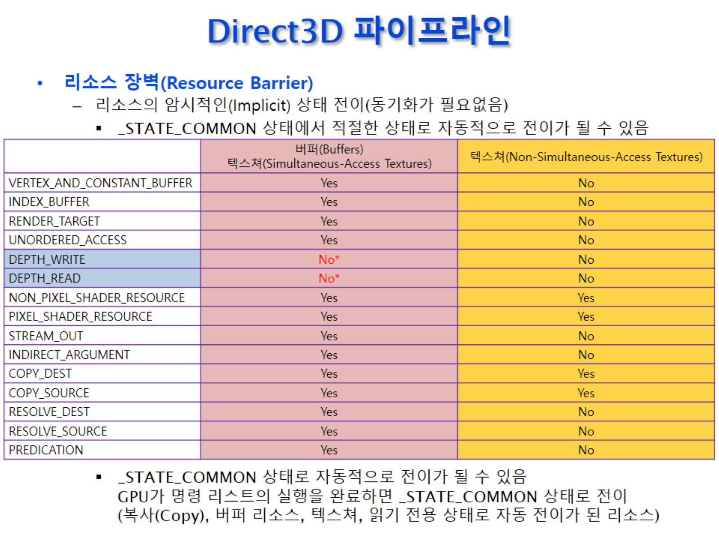
Direct3D 파이프라인
Notes:
COMMON은 특별한 상태를 정해주지 않은것. -> 그래픽스 커맨드를 사용할때 자동적으로 0라는 상태를 이 명령어에 실행 할 수 있는 상태로 자동으로 바꿔준다.
Depth버퍼로 나타내는 상태는 자동으로 바뀌지 않는다.
다른 상태로 바뀌고 모든 큐가 다 실행되면 자동으로 COMMON으로 바뀐다.

Slide 4
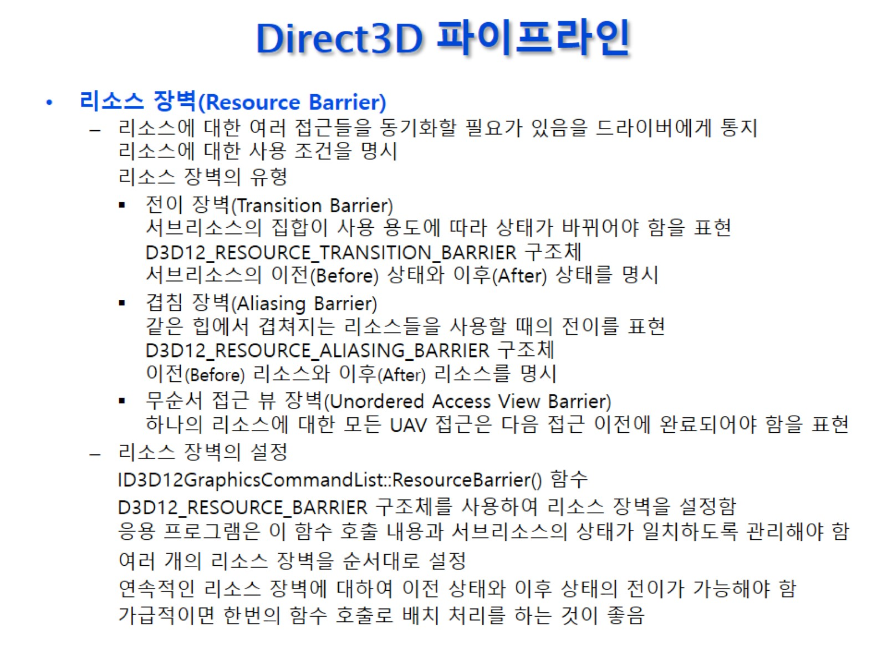
Direct3D 파이프라인

Slide 5
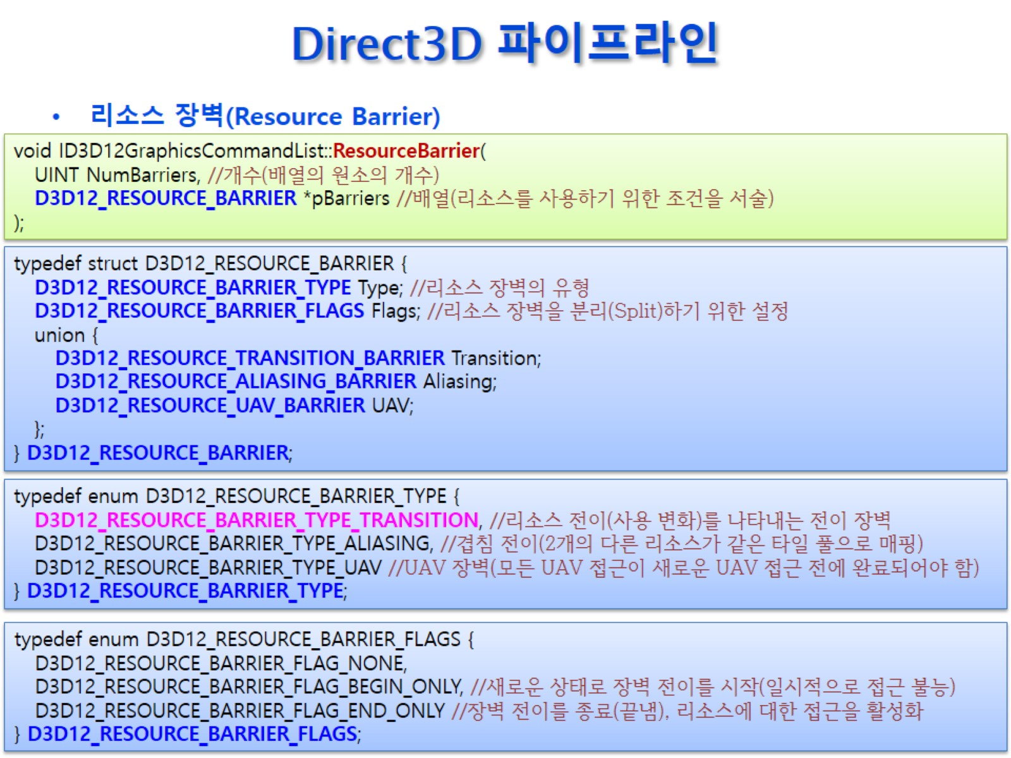
Direct3D 파이프라인
Notes:
커맨드리스트의 맴버함수이고
여러 배리어를 만들어도 되고 하나만 만들어도 된다.
Flag를 이용하며 또 스플릿할 수 있지만 골치아프니까 None을 쓴다.
D3D12_RESOURCE_BARRIER_TYPE_TRANSITIONA transition barrier that indicates a transition of a set of subresources between different usages. The caller must specify the before and after usages of the subresources.
D3D12_RESOURCE_BARRIER_TYPE_ALIASINGAn aliasing barrier that indicates a transition between usages of 2 different resources that have mappings into the same tile pool. The caller can specify both the before and the after resource. Note that one or both resources can be NULL, which indicates that any tiled resource could cause aliasing.
D3D12_RESOURCE_BARRIER_TYPE_UAVAn unordered access view (UAV) barrier that indicates all UAV accesses (reads or writes) to a particular resource must complete before any future UAV accesses (read or write) can begin.
D3D12_RESOURCE_BARRIER_FLAG_NONENo flags.
D3D12_RESOURCE_BARRIER_FLAG_BEGIN_ONLYThis starts a barrier transition in a new state, putting a resource in a temporary no-access condition.
D3D12_RESOURCE_BARRIER_FLAG_END_ONLYThis barrier completes a transition, setting a new state and restoring active access to a resource.

Slide 6
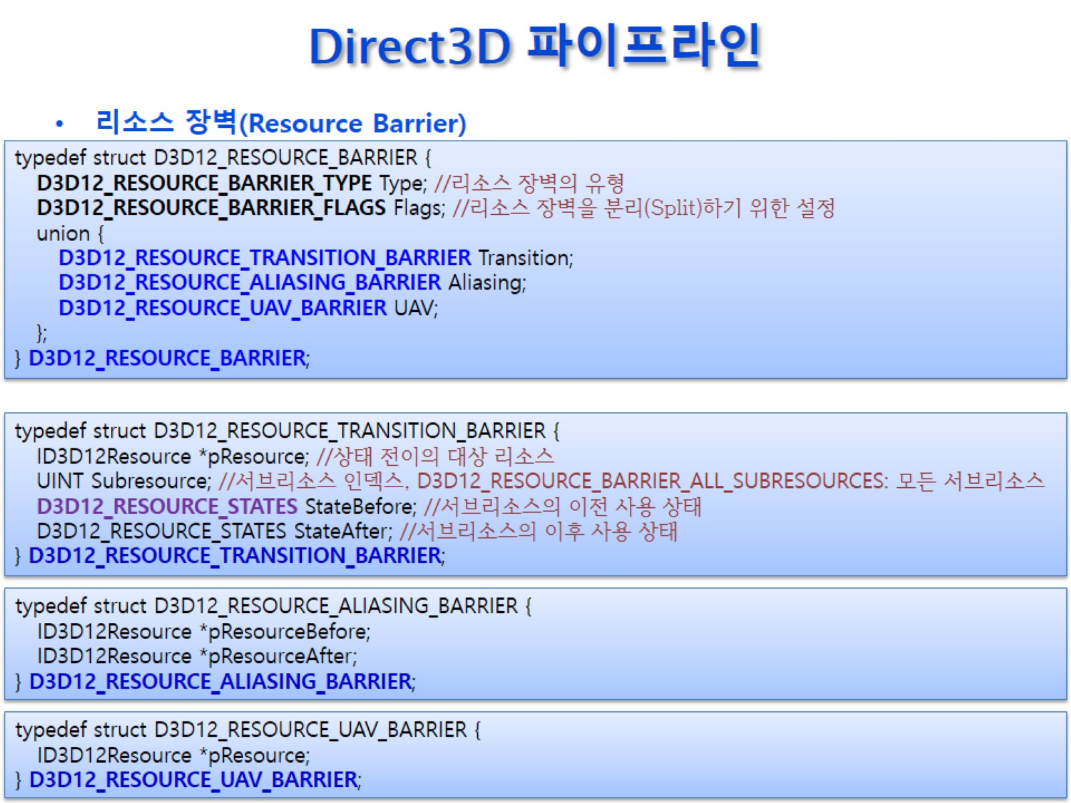
Direct3D 파이프라인
Notes:
상태전이를 하고 싶은 대상 리소스를 넣고 버퍼는 subresource가 없으므로 주고 올-서브리소스를 쓴다.
상태전이를 하는 건 그래픽 드라이버가 한다.
B라는 상태가 아닐때 상태 일치하지 않는 명령을 실행하려 하면 오류가 발생할 거다.
모든 명령어실행은 우리가 책임져야 한다.

